Slide 1
Data analytics class Data Presentation

Slide 2



Project analysis slide 2
Project 1 Analysis
Age
The goal of this project is to investigate the three factors that may be beneficial for our marketing team.
Exploring the points that need more attention and ensure targeting is directed to the correct potential students.
Marketing
project
Gender
Location

Slide 3
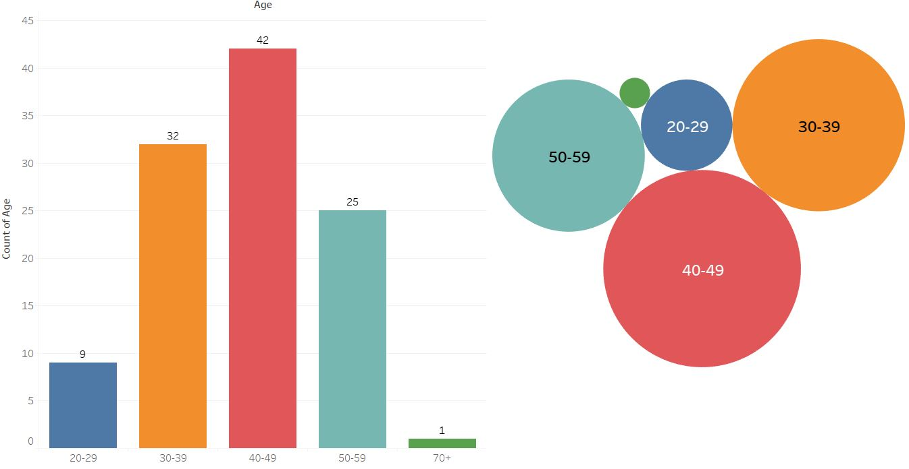
Project analysis slide 5
Age Analysis
0.92%
8.26%
29.36%
22.94%
38.53%
From 40 to 49
From 30 to 39
From 50-59
38.53%
29.36%
22.94%
40-49 age has the highest percentage of our students currently enrolled in data analytics course
30-39 comes the second with almost 30% of total
50-59 comes as third but with high percentage of almost the quarter of the total.

Slide 4
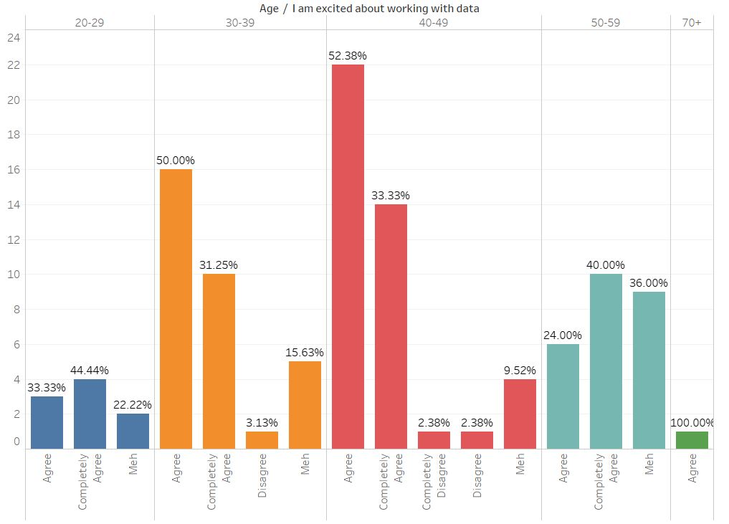
Project analysis slide 5
Age/ excited about working with data
40-49
85.71% Excited
30-39
81.25% Excited
50-59
64.00% Excited
20-29
77.77% Excited
Agree - completely agree (Positive)
Disagree – completely disagree – Meh (Negative)
Exploring how student excited about working with data based on their age?

Slide 5
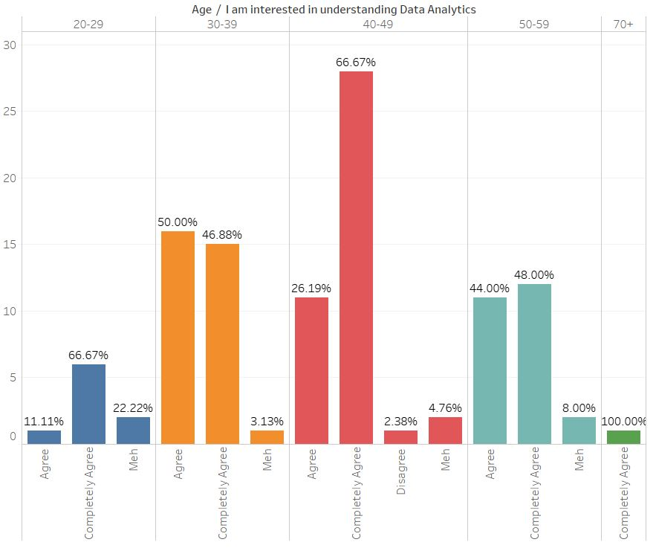
Project analysis slide 5
Age/ interested in understanding data
40-49
92.86% Interested
30-39
96.88% Interested
50-59
92.00% Interested
20-29
77.78% Interested
Agree - completely agree (Positive)
Disagree – completely disagree – Meh (Negative)
Exploring how student interested to understand data analytics based on their age?

Slide 6
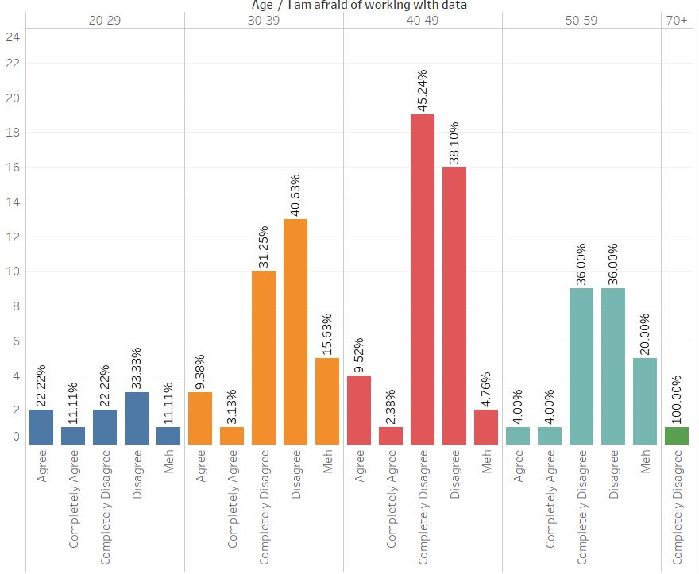
Project analysis slide 5
Age/ afraid of working with data
40-49
83.38% Not Afraid
30-39
71.88% Not Afraid
50-59
72.00% Not Afraid
20-29
55.55% Not Afraid
Disagree – completely disagree (Not Afraid)
Agree - completely agree - Meh (Afraid)
Exploring how student are afraid of working with data based on their age?

Slide 7
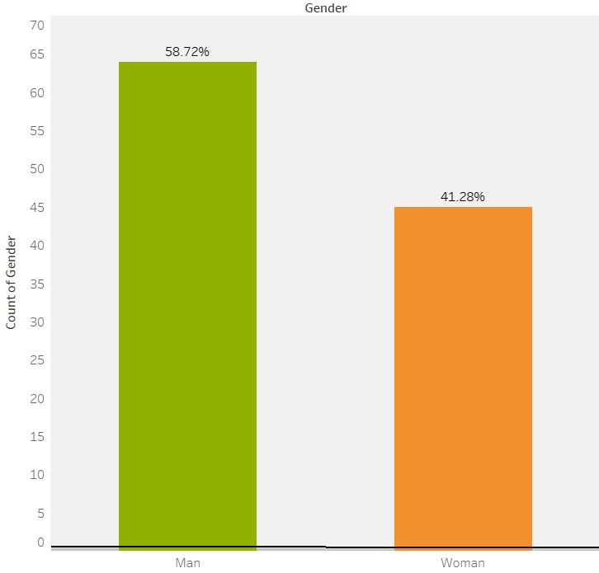
Project analysis slide 5
Gender Analysis
Men
58.72%
Men are more than women, 64 out of 109 are Men.
Women
41.28%
Women are less with 46 out of 109.

Slide 8
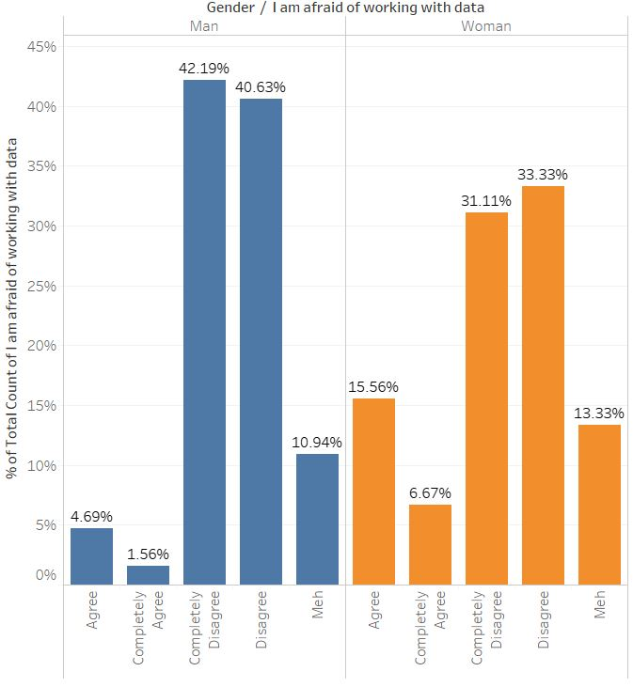
Project analysis slide 5
Gender/ Afraid of working with data
6.25%
of Men
Are afraid of working with data
22.23%
of women
Are afraid of working with data
Agree - completely agree (Afraid)
Exploring how student are afraid of working with data based on their gender?

Slide 9
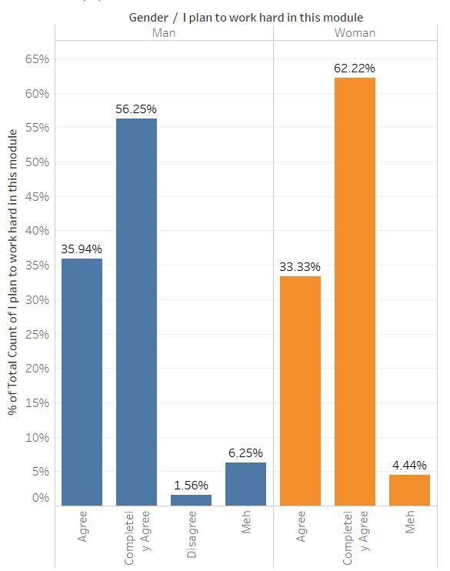
Project analysis slide 5
Gender/ Planning to work hard
92.19%
of Men
Are planning to work hard in this module
95.55%
of women
Are planning to work hard in this module
Agree - completely agree (work harder)
Exploring if students are planning to work hard with data based on their gender?

Slide 10
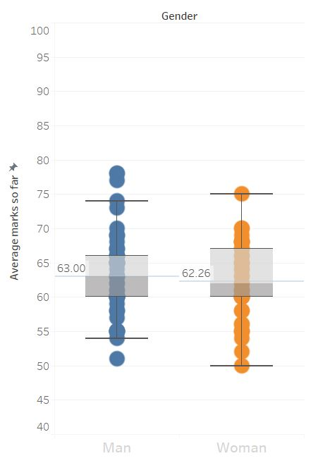
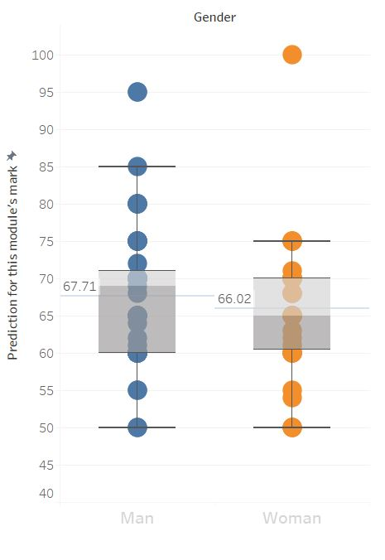
Project analysis slide 5
Gender marks’ Analysis
Boxplot for average marks so far between men and women
Boxplot for prediction for this module's mark between men and women

Slide 11
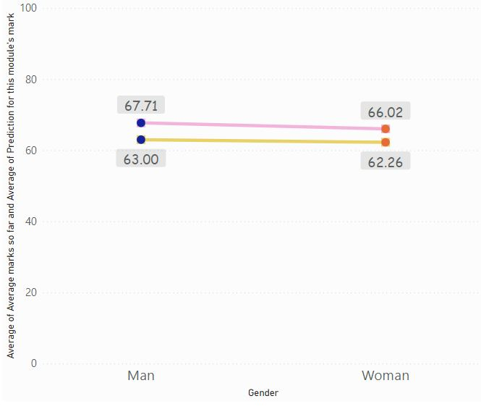
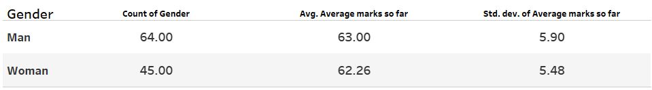
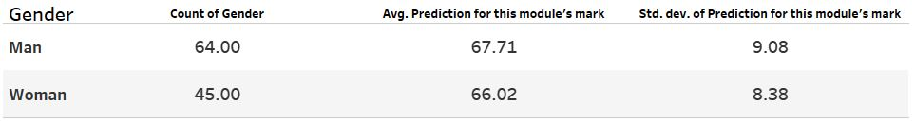
Project analysis slide 5
Gender Analysis
The average of prediction of this module is 67.71 for men and 66.02 for women
The average of “Prediction of this module’s mark”
The average of “Average marks so far”
The average of average marks so far is 63.00 for men and 62.26 for women

Slide 12
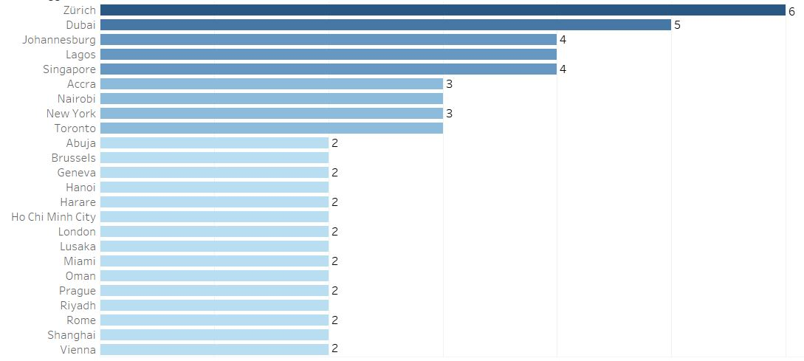
Project analysis slide 5
Cities Analysis
The top cities with at least 2 students currently studying data analytics, Zurich at the top with 6 followed by Dubai 5 student, then Johannesburg, Lagos and Singapore by 4 students each.

Slide 13
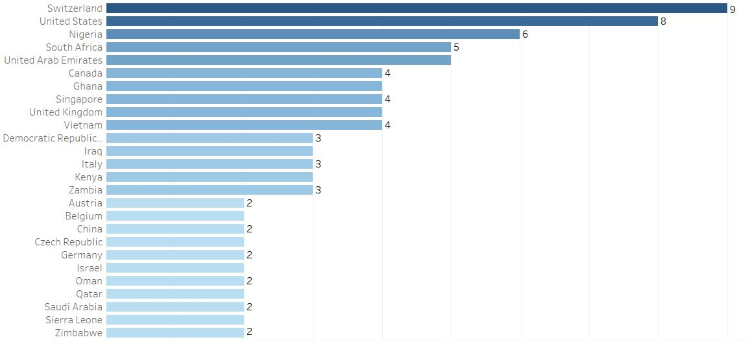
Project analysis slide 5
Countries Analysis
The top countries with at least 2 students currently studying data analytics, Switzerland 9, followed by United States 8, and Nigeria 6.

Slide 14
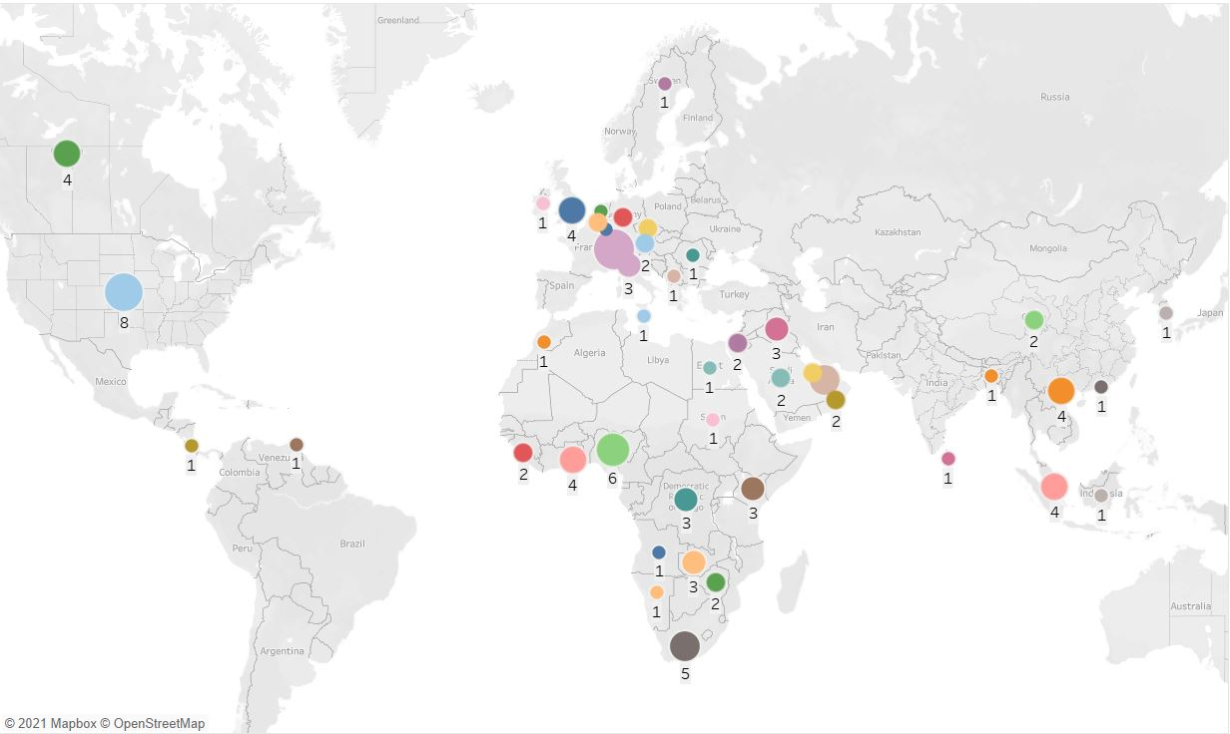
Project analysis slide 5
Location (map) Analysis

Slide 15
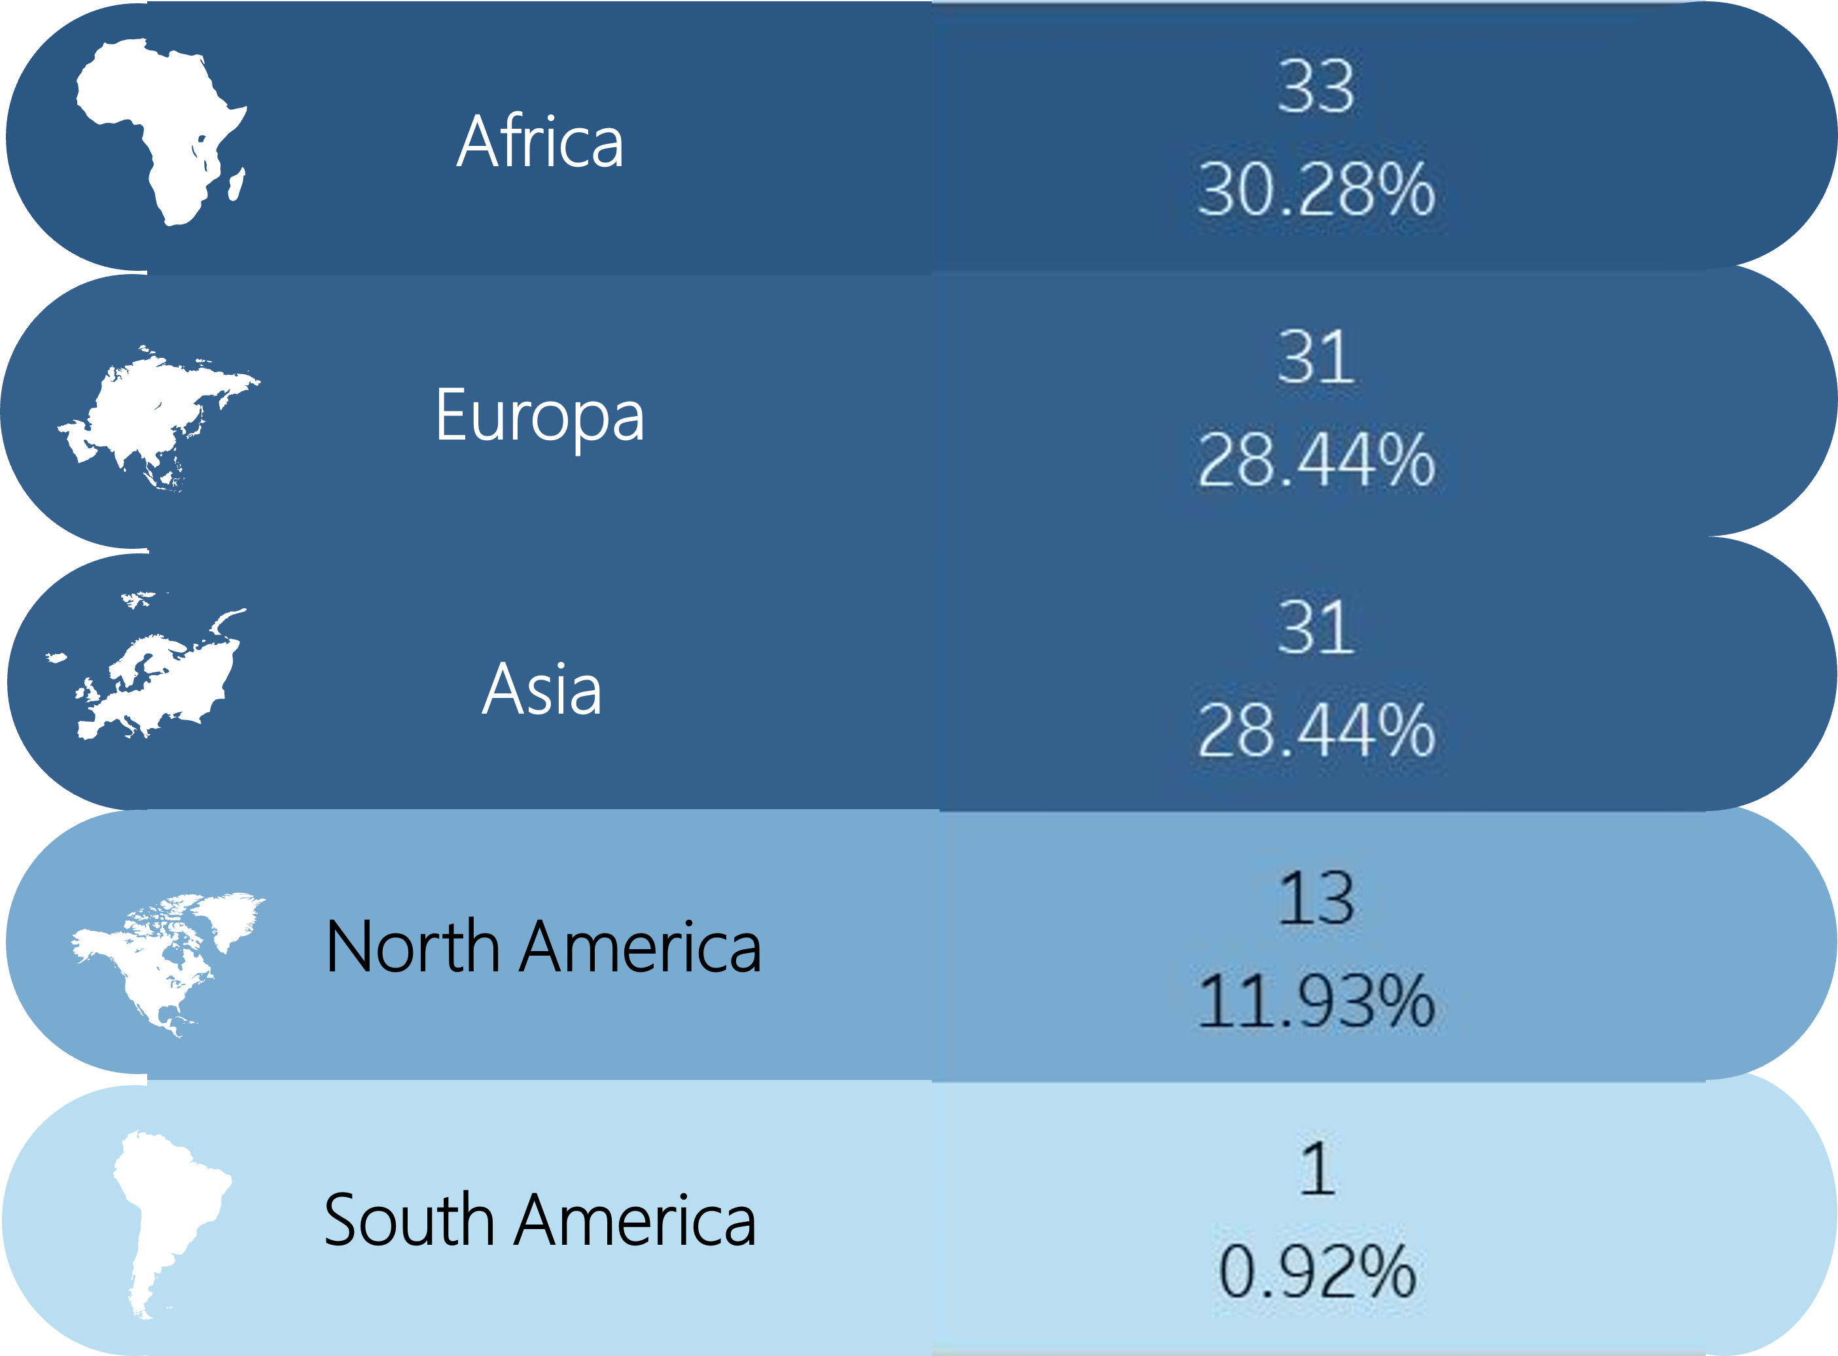
Project analysis slide 5
Location Analysis

Slide 16
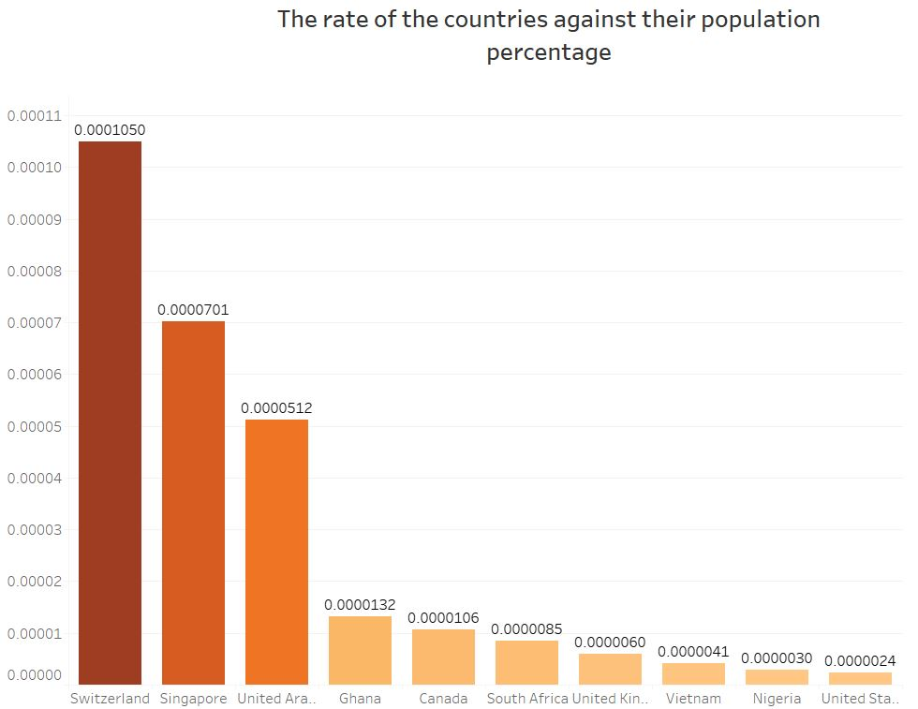
Project analysis slide 5
Countries/population Analysis

Slide 17
Project analysis slide 8
Project 1 Outcome
Significant
Not Significant
Age
Gender
Age is considered a significant factor on targeting potential data analytics students, as analysis explained age can determine if the students will be interested on studying data analytics more than others.
Despite of men are greater than women, analysis indicated that there is no different between women and men on their potential of studying data analytics.
Location
The student’s location also plays an important role of figuring out where our most of student live and what are the overlooked places to direct our marketing to, such as the whole continent of Australia is missed and very low enrolment from South America.

Slide 18



Project analysis slide 2
Project 2 Analysis
How much new students expect to get?
The goal of this project is to analyze the prediction marks of the data analytics module and the previous modules score against the number of modules completed to understand the knowledge of the students about marking system.
Marking system
Is their any changes in the expectations?
After how many modules their expectations changed?

Slide 19
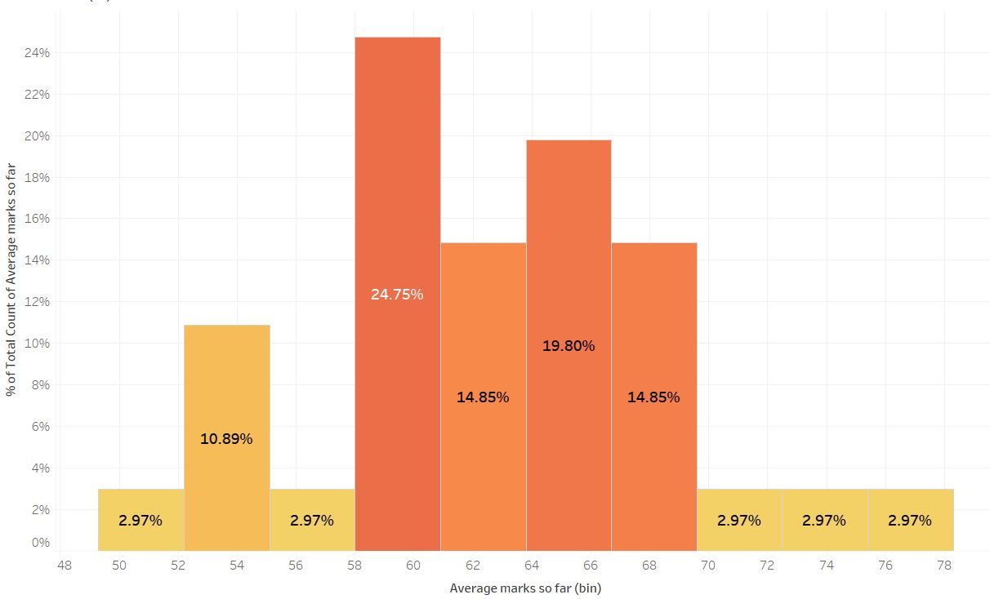
Project analysis slide 5
Average marks so far Analysis
74.25%
of the population score between
58 to 69
The distribution of average marks so far

Slide 20
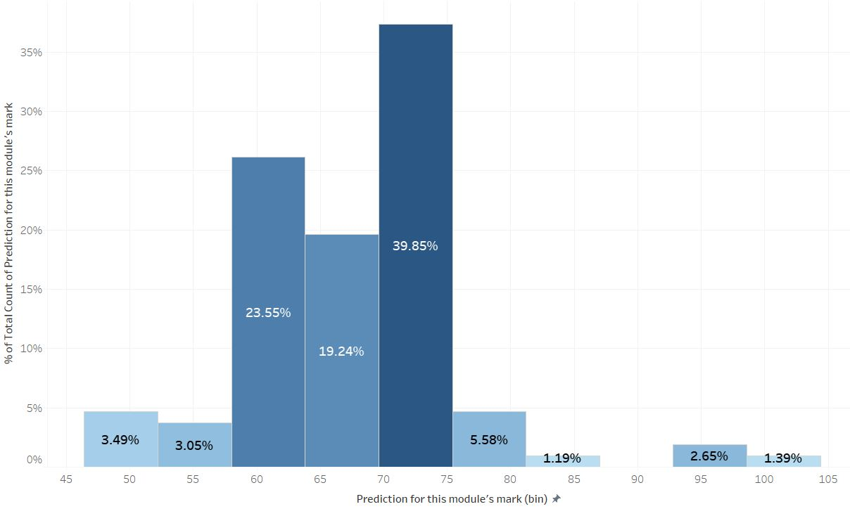
Project analysis slide 5
Prediction of this module’s marks Analysis
82.64%
of the population predict to score between
60 to 75
The distribution of prediction for this module’s marks

Slide 21
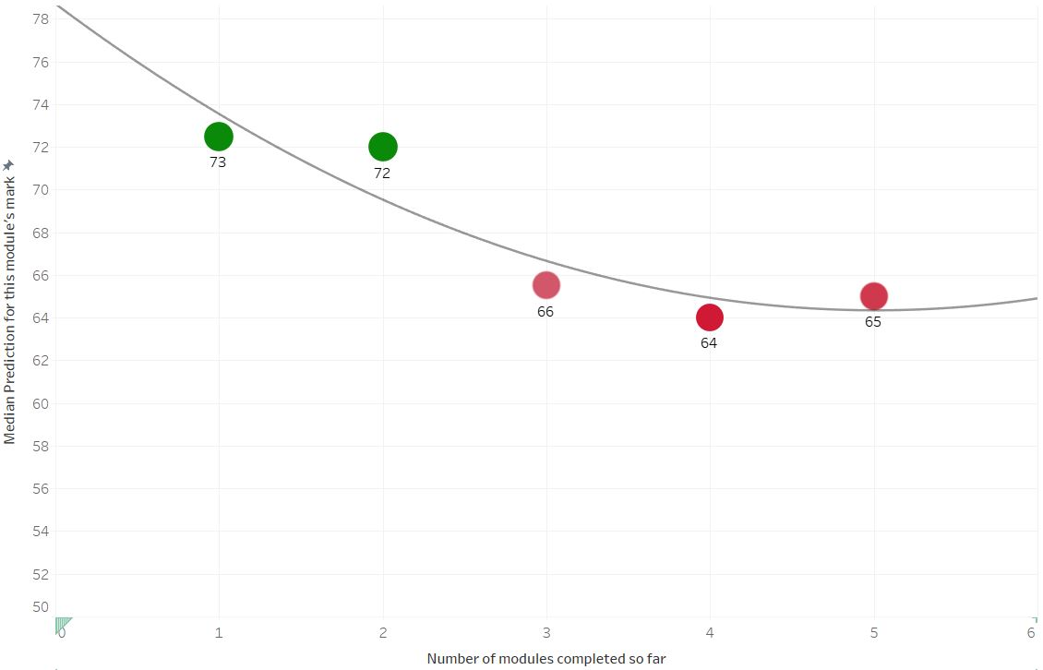
Project analysis slide 5
Prediction of this module’s marks Analysis
Completed one or two modules
72 to 73
The average expected marks of new students is greater than 70.
Completed three, four or five.
64 to 65
The average of expected marks of students completed more than two modules dropped down to 64.

Slide 22
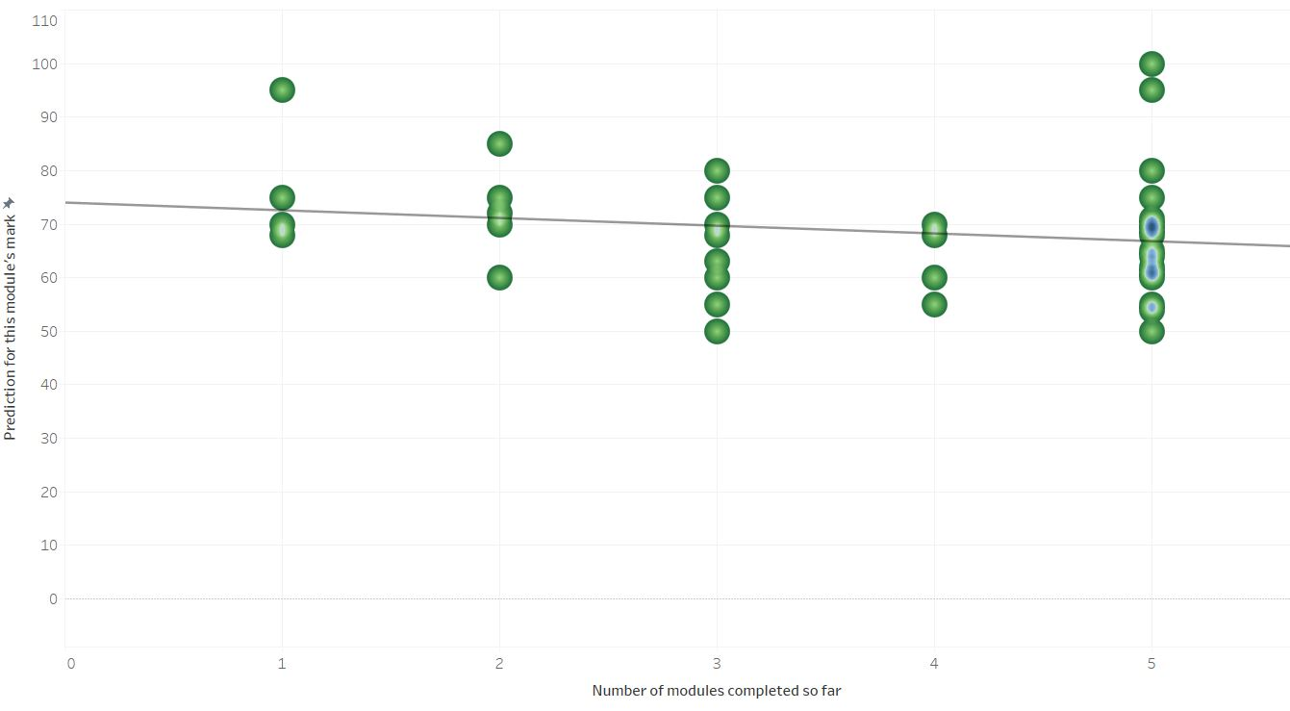
Project analysis slide 5
Prediction slop Analysis
Drop of marks by -1.44284 when number of modules increase by one

Slide 23
Project analysis slide 8
Project 2 Outcome
Business problem
Outcome
How much new students expect to get?
Above 70%
Is their any changes in the expectations?
Yes, students' expectations dropped down
After how many modules their expectations changed?
After the second module

